Slide 1
Mapping Powerline RFI
What do you need?
How do you begin?
How do you analyze the results?
Follow up

Slide 2
Is it Powerline Noise?
Characteristic 8 MS audio peaks – may be more than one. The noise may go away in wet weather when water fills in “microgaps.”
Buzzing sound on AM
Since the fundimental is at 120 Hz, the noise is strongest at low frequencies, e.g. the AM broadcast band and less at higher frequencies.
Resonant antennas will make the noise stronger on those frequencies for which they were designed. HF hunting is therefore done with non-resonant short loops or sticks.

Slide 3
What Do you Need?
IC705 that includes CI-V S-meter export and GPS.
Quiet (RFI) vehicle.
RFI-quiet Windows laptop running W4DD software (Win10,11.)
Interconnecting cable with ferrites for RFI suppresson.
10 meter mobile antenna (e.g. hamstick.)

Slide 4
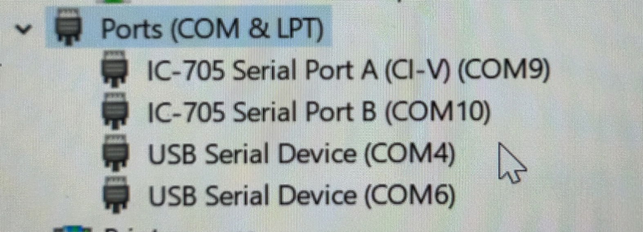
Setting up the PC
Download the W4DD software (contact me)
Install the usb drivers from the Icom web site
You may need a Google account for MyMaps

Slide 5
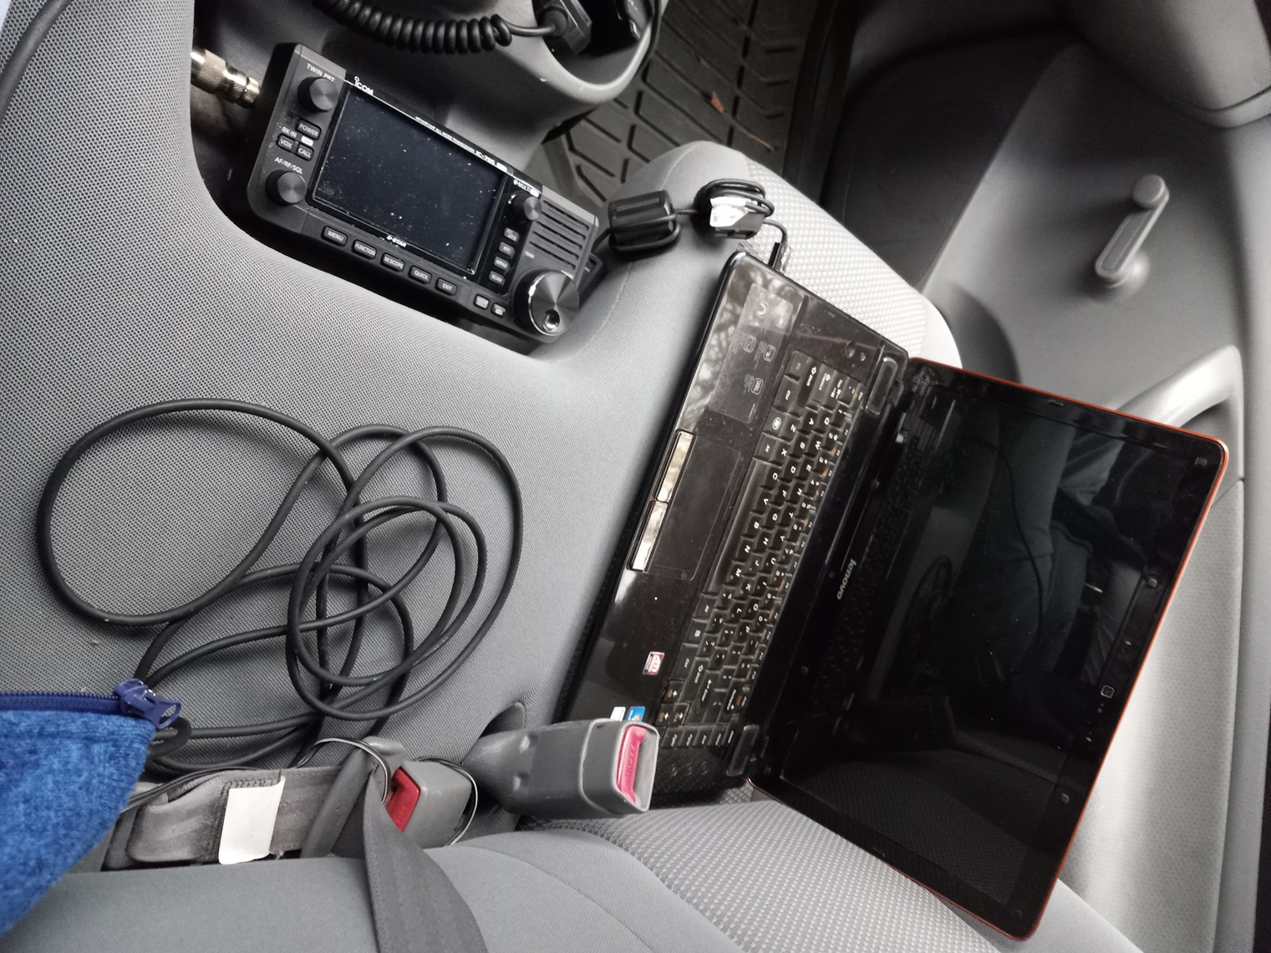
Win10 Laptop connected to IC705 with microUSB to USB cable

Slide 6
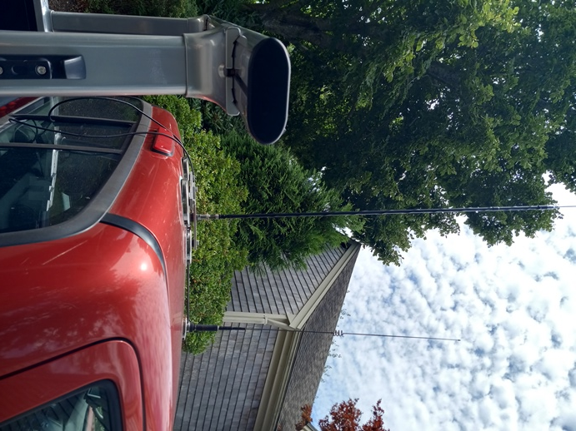
10M Hamstick on three magnet mag mount (behind 2M/70 cm mag mount.

Slide 7
Why 10M Mobile?
Powerline noise propagates down the power line.
This smears the noise signature at low frequencies and makes identification of a specific pole difficult.
28 MHz is sufficiently high in frequency to identify a cluster of suspect poles.
Haven’t tried 6M but I suspect similar behavior. Might be better.

Slide 8
HF VS. VHF Noise Profiles
HF
VHF
Powerline
Noise Source

Slide 9
How Do You Begin?
Take a partner with you – you concentrate on driving!
Identify an area of interest (beam headings, topography, etc.)
Use the AM mode on the IC705.
Note hills are strong RFI attenuators and the more beam headings affect the noise, the further away it is.
Start up the software and drive the area. A speed of 30 mph usually works well. Be aware of traffic!
When in doubt, cover more territory than you plan to.
Factor the weather into your plans…wet weather can make power line RFI go away! (the microgaps fill in)

Slide 10
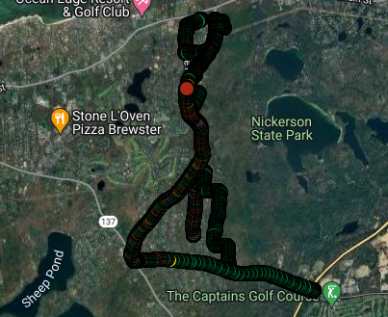
Where Should I Look?
APPROX BEAM HEADING
QTH

Slide 11
Data in the RFI Data Folder
SAMPLE LATITUDE LONGITUDE S-MTR ELEVATION SATS
456 | 41.76333 | -70.0441 | 9 | 129 | 7
457 | 41.76331 | -70.044 | 10.5 | 129 | 7
458 | 41.76329 | -70.044 | 9 | 128 | 7
459 | 41.76328 | -70.0439 | 6 | 126 | 7
460 | 41.76326 | -70.0438 | 8 | 122 | 7
461 | 41.76324 | -70.0438 | 9.5 | 120 | 7
462 | 41.76323 | -70.0437 | 8.5 | 118 | 7
463 | 41.76321 | -70.0436 | 9.5 | 116 | 7
464 | 41.76319 | -70.0435 | 11 | 114 | 7
465 | 41.76317 | -70.0434 | 10.5 | 113 | 7
466 | 41.76316 | -70.0433 | 9.5 | 110 | 7

Slide 12
Analyzing the Results
Import the data into Google My Maps
Set up the color scheme to make high noise areas clear…e.g. S1 – S8 in green, S9 in yellow, S9+ in orange, S9+20 in red, S9+30 in black.
Change the markers to plain circles for easier reading.
Identify power pole areas with high noise signatures.

Slide 13
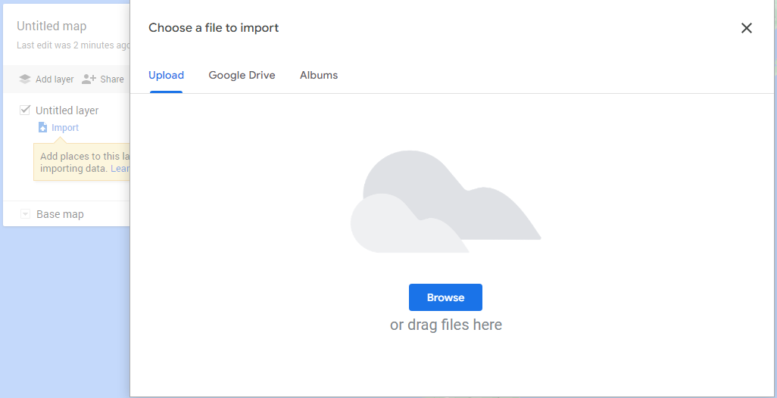
Importing the Data

Slide 14
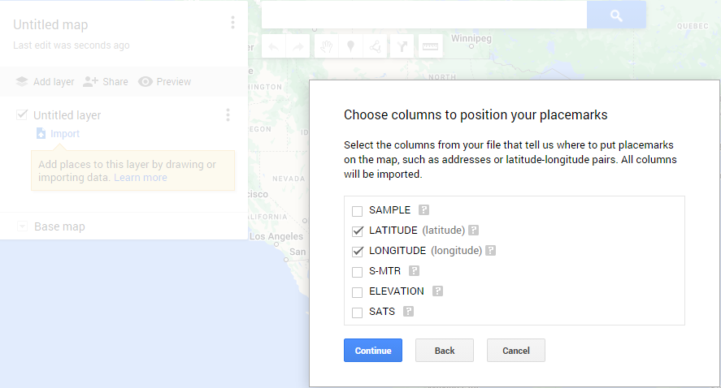
Select Data to be Mapped

Slide 15
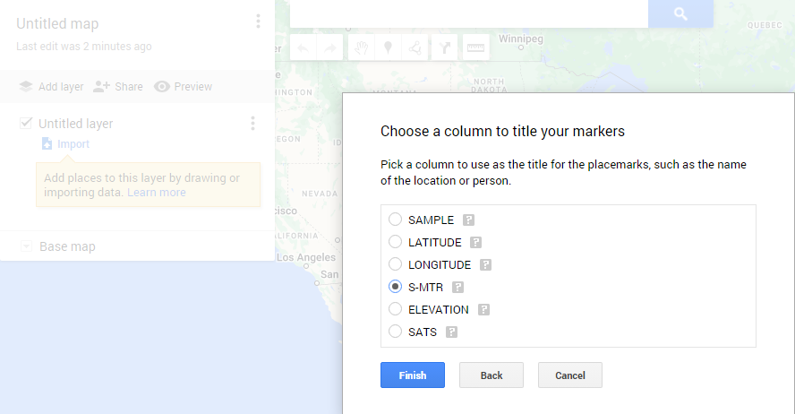
Customizing the Map for Analysis

Slide 16
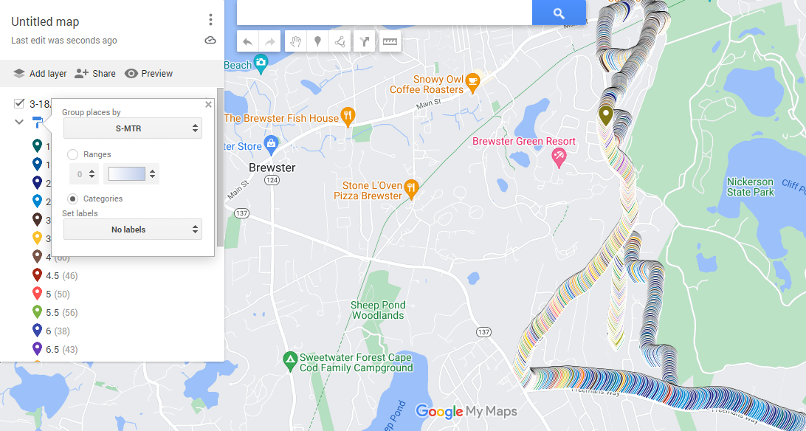
Select S-meter Color Coding

Slide 17
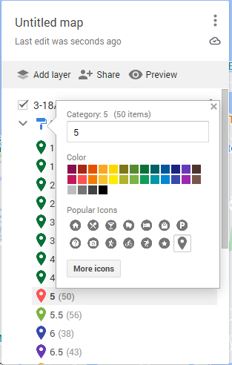
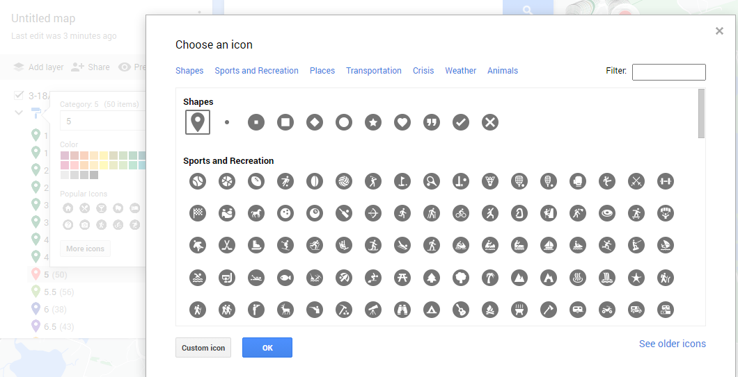
Color and Symbol Selection

Slide 18
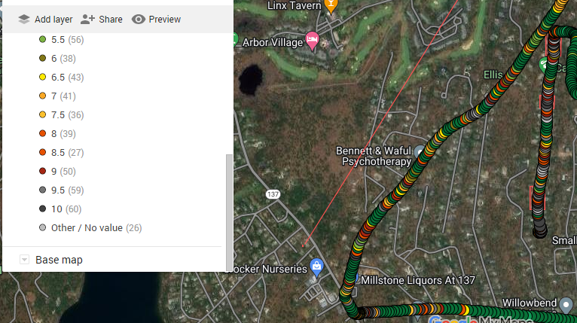
Reviewing the detail with modified noise symbols

Slide 19
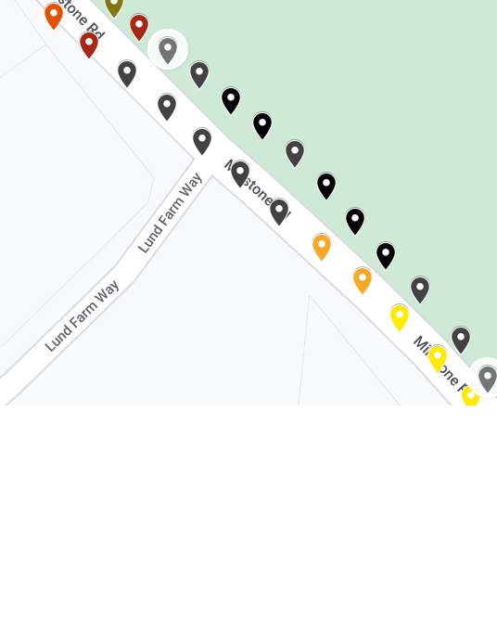
Part of the plot showing high
noise in the vicinity of
Millstone Rd. and
Lund Farm Way

Slide 20
Follow Up
Use VHF yagi and IC705 to locate specific pole.
Use ultrasonic dish to ID specific noisy component
Candidates are line ties, transformers, lightning arrestors, cracked insulators…
Report problem to power company…state location, NOT pole number and get a case number.

