Slide 1
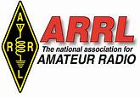
Rob Leiden K1UI
NE Assistant Director
Spectrum Protection & Utilization(SPU)
ANNETTE CONTICCHIO KA1RFI
RFI COORDINATOR
EVERSOURCE NEW HAMPSHIRE
New England Division
Fred Kemmerer AB1OC, Director
Notes:
Hello and thanks for selecting this presentation. MY name is rob leiden, k1ui. I’m the ARRL assistant New England director for spectrum protection and use. We now have an on-line radio frequency interference guide to help hams to find and remove rfi sources in and outside the home. We’ll use a case study for power line interference to introduce the process to you.

Slide 2
There’s a lot to know about RFI
Notes:
I’m just getting started learning about RFI but there’s already been a lot of research and a lot of writing about it.

Slide 3
Case Study – How We Can Partner with the Power Company to Find and Fix RFI
ew England Division
New England Division
Fred Kemmerer AB1OC, Director
Notes:
We’ll use the example of power line RFI to introduce the on-line RFI troubleshooting guide to you.

Slide 4
A ham hears loud noise not heard before
New England Division
New England Division
Fred Kemmerer AB1OC, Director
What does it sound like?
What frequencies is it on?
Is it coming from a particular direction?
Can you see it on a spectrum scope?
How strong on each frequency
Notes:
You may start to hear interfering noises that are strong enough and widespread enough to affect your operating.

Slide 5
Is it coming from your house?
New England Division
New England Division
Fred Kemmerer AB1OC, Director
nediv.arrl.org/rfi-troubleshooting-guide
Logic tree to guide investigation and help document the problem
Process takes you to RFI team page to communicate the problem to the team or report what you’ve found and fixed
Notes:
The most important first step is to determine if the noise is coming from a source inside or outside your home. The guide takes you through some steps to accomplish this and document your actions on a form that your Section’s RFI Team can use if you need help. It also creates a record of what you’ve found so that we can start building a database of these RFI sources.

Slide 6
What will the team do?
New England Division
New England Division
Fred Kemmerer AB1OC, Director
Follow up with the information you provided in the form
If needed, visit your area to see if the source of the RFI can be located
Notes:
If you need help, the team will provide over-the-phone advise, intercede with power companies and other utilities, interact with the ARRL Lab and perform site visits as needed for each case. The on-line pages include a team contact page and report form page to provide points of contact and case information.

Slide 7
What tools do the RFI teams have? What is their value added?
New England Division
New England Division
Fred Kemmerer AB1OC, Director
The standard team equipment sets are seen on the page: nediv.arrl.org/rfi- team-toolkit.
The teams will have experience using the tools, receive training and
will be viewed by the utilities as a trusted point of contact with the
amateur community.
Notes:
The RFI teams will gather case information and establish points of contact with power companies and the ARRL Lab. Hey will have equipment that will allow them to help find RFI sources.

Slide 8
The team finds the pole that the noise is coming from…now what?
New England Division
Fred Kemmerer AB1OC, Director
Need to open a case with the utility – but how do you fund the right contact?
- check nediv.arrl.org/new-england-power-company-contacts/
Pole ID is best done with address and pictures. Numbers may not be accurate.
Some additional characteristics of power line noise:
- rarely under 1000 volts
- Two modes: corona discharge and microgap. Noise decays
at different rates with increasing frequency
Notes:
Power line RFI is of concern to the power company. RFI is often an indication of a component failure. Besides the regulatory obligations, power companies want to avoid unplanned outages. From a ham’s perspective, it is best when we regard finding power line RFI as a partnership between hams and the power company.

Slide 9
Now what happens?
New England Division
New England Division
Fred Kemmerer AB1OC, Director
Each power company is slightly different but all start with the call center originating a case record.
Some have teams that investigate and get engineering help if needed.
Some have the maintenance department put the case on their work schedule.
Each PUC or PSC has standards for investigating and resolving cases and the FCC has a guideline of 60 days for complaint resolution. In general, working to resolve complaints before involving third parties yields the best results.
Power companies understand that RFI issues are often indications of component failures. Complete, credible RFI reports help them to avoid unplanned outages.
Notes:
The on-line web pages for troubleshooting RFI include each contact number for power companies in New England. Once a problem is identified, opening a case with the call center starts the process of having the power company fix the problem. The FCC has a guideline of 60 days for a response. Each company has a slightly different process and the way they communicate back to you may be different as well.

Slide 10
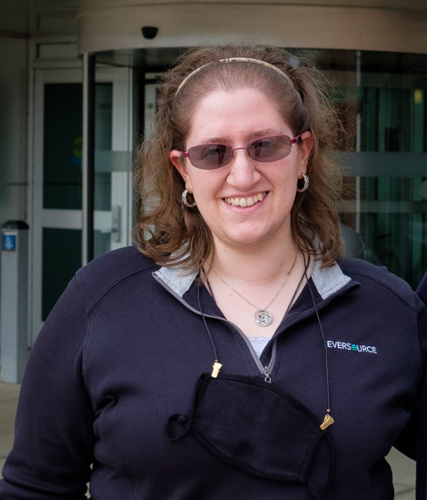
Annette Conticchio KA1RFI
New England Division
Fred Kemmerer AB1OC, Director

Slide 11
Information Received by Eversource NH
New England Division
Fred Kemmerer AB1OC, Director
Annette receives information from customer service, initiates case, and calls customer directly to gather any additional information needed and to provide direct contact info and next steps.
Also asks for best way to contact customer so can provide updates and keep customer informed
If information reported to Eversource NH from ARRL RFI team, will reach out to both ARRL team and customer to provide contact information and updates

Slide 12
Dispatching Crews
New England Division
Fred Kemmerer AB1OC, Director
Investigative crews are dispatched to identify potential causes of RFI
These are often electricians or RFI specialists with special equipment to identify the exact source of RFI
Once identified, appropriate crews are dispatched to make repairs
Both of these steps can take time – safety and customer outages, including storm restoration and mutual aid, are the primary goals of any electric utility.

Slide 13
Resolving RFI Issues
New England Division
Fred Kemmerer AB1OC, Director
Once repairs are made, Annette will reach out to the customer to ensure RFI is resolved
If resolved, the ARRL RFI team is notified and the case closed
If unresolved, the process repeats until resolved

Slide 14
Things to Know about RFI Resolutions
New England Division
Fred Kemmerer AB1OC, Director
Sometimes, RFI can be emanating simultaneously from multiple sources, so resolving one source may not affect the RFI being observed.
Sometimes, a second RFI source will be audible after the first is resolved. If this is the case, the process repeats until this source is resolved as well.
There’s more than just power utility equipment on a pole – the source of the RFI may be from other utility equipment
PLEASE do NOT use the “sledgehammer” test – may cause damage to equipment and potential injury

Slide 15
Remember…
New England Division
Fred Kemmerer AB1OC, Director
RFI issues can be indications of potential component failures. Complete, credible RFI reports can help avoid unplanned outages and are always appreciated!
Please don’t ever hesitate to reach out if you believe a source of RFI to be emanating from power line equipment!

Slide 16
THANK YOU!!!
New England Division
Fred Kemmerer AB1OC, Director
Q&A

